Slide 1

Connecting Mobile Apps to Remote Databases
Welcome to our comprehensive guide on connecting mobile apps to remote databases. This presentation will explore how your favorite apps update in real-time, the methodologies that make this possible, and best practices for secure and efficient database connectivity.
We'll examine RESTful APIs, GraphQL, WebSockets, and practical applications like user authentication and data synchronization. By the end, you'll understand how to optimize network usage, handle errors, secure data, and ensure your mobile applications deliver a seamless user experience.

Slide 2




Why Connect Mobile Apps to Remote Databases?
Efficient Data Access
Real-Time Updates
Optimized Performance
Mobile apps connect to remote databases to efficiently access, store, and manage data without consuming excessive device storage.
Remote connections ensure users always receive the most current information without manual refreshing.
Apps retrieve only necessary information from remote databases, ensuring smooth performance even with large datasets.

Slide 3

Real-World Example: Flight Booking
The Challenge
The Solution
The Benefit
Flight booking apps need to display thousands of constantly changing flight schedules, prices, and seat availability without overwhelming the device's storage or processing power.
Instead of storing all flight data locally, the app retrieves only the specific information requested by the user from a remote database, ensuring both real-time accuracy and optimal performance.
Users receive up-to-date flight information instantly while enjoying a responsive app experience, regardless of how much flight data exists in the complete database.

Slide 4






Common Connection Methodologies
GraphQL
Query language allowing clients to request only needed data, reducing bandwidth
RESTful APIs
Widely used architectural style for networked applications using HTTP methods
WebSockets
Continuous connection enabling real-time communication without repeated requests

Slide 5
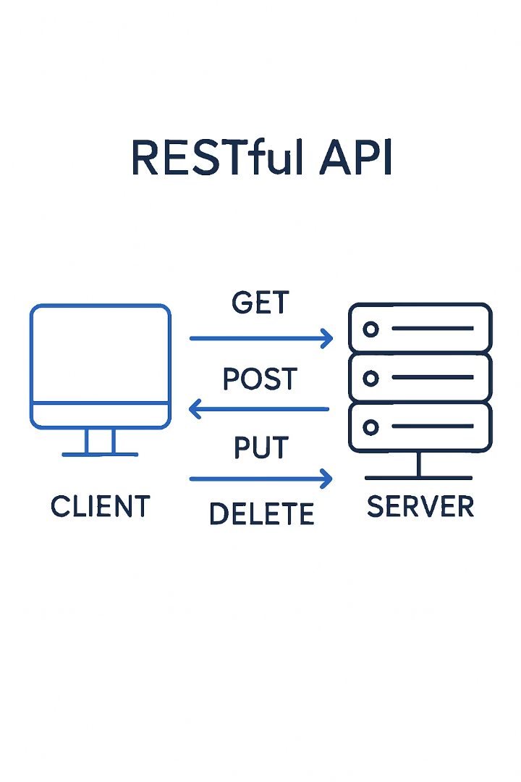
Understanding RESTful APIs
What is REST?
How It Works
Representational State Transfer (REST) is an architectural style for designing networked applications that communicate over HTTP using standard methods.
RESTful APIs allow apps to send requests to servers using specific HTTP methods, which process these requests and return structured responses, typically in JSON format.
Key Benefits
Widely adopted, easy to implement, stateless operations, and excellent compatibility with web infrastructure make REST a popular choice for mobile app connectivity.

Slide 6
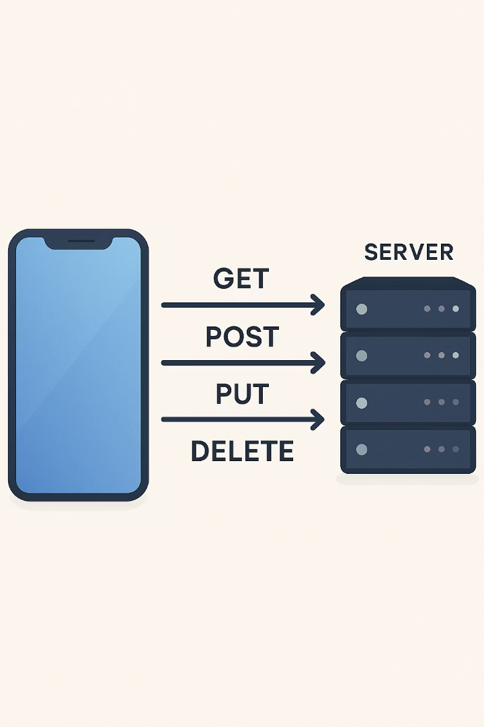




RESTful API HTTP Methods
GET
POST
PUT
Retrieves data from the server, like fetching a user profile or product details
Sends new data to the server, such as creating a new user account or adding a product
Updates existing data on the server, like modifying user information or product details
DELETE
Removes data from the server, such as deleting a user account or removing a product

Slide 7





RESTful API in Action: Travel App Example
User Searches
User enters flight search criteria in the travel app
GET Request
App sends GET request with search parameters to server
Server Processes
Server queries database and prepares flight data
JSON Response
Server returns available flights in JSON format

Slide 8






Understanding GraphQL
Precise Data Retrieval
Request only needed data fields
Schema Definition
Structured data types and access patterns
Performance Optimization
Reduced bandwidth and improved speed
GraphQL offers a more efficient way to communicate with databases by allowing clients to request only the specific data they need. This precision reduces bandwidth usage and improves app performance, especially on slower networks or less powerful devices.
Developers define a schema that describes all available data types and how clients can access them, creating a clear contract between client and server. This approach eliminates over-fetching and under-fetching of data that commonly occurs with traditional REST APIs.

Slide 9



Understanding WebSockets
Continuous Connection
Persistent bidirectional communication
Real-Time Updates
Instant data sharing without polling
Interactive Applications
Ideal for chat and live updates
For apps that need real-time communication, such as chat applications or live sports updates, WebSockets provide a continuous connection between the user's device and the server. This enables instant data sharing without the need to refresh or send repeated requests.
Unlike RESTful APIs where each interaction requires a new connection, WebSockets maintain an open channel, significantly reducing latency and enabling truly interactive experiences. This technology is essential for applications where immediacy is critical to the user experience.

Slide 10

Real-World Use Case: User Authentication
Credential Submission
User enters login credentials in the mobile app, which are sent to the server via a secure API call (typically POST request with HTTPS).
Server Verification
Server validates credentials against the database, checking username/email and password hash to confirm the user's identity.
Token Generation
Upon successful verification, server generates an authentication token (JWT or similar) and returns it to the mobile app.
Secure Access
App stores the token securely and includes it in subsequent requests to authenticate the user without requiring repeated logins.

Slide 11








Real-World Use Case: Data Synchronization
Local Storage
Connection Detection
App stores data in local database like SQLite while offline
App detects when network connection is available
Download Updates
Upload Changes
Remote changes are fetched and merged locally
Local changes are sent to remote database
Data synchronization is crucial for apps that need to operate offline. Developers use local databases like SQLite to store data when the device is offline, and once connected, the app synchronizes this data with the remote database, providing a seamless user experience regardless of connectivity status.

Slide 12

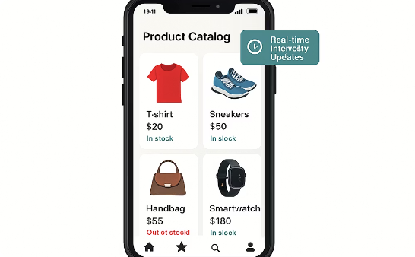

Real-World Use Case: Dynamic Content Management
News Applications
E-Commerce Platforms
Social Media
News apps fetch the latest articles and headlines from content management systems, ensuring users always see the most current stories without app updates.
Shopping apps display current product availability, pricing, and promotions by connecting to inventory management systems through APIs.
Social platforms retrieve personalized content feeds, notifications, and interaction updates through continuous database connections.

Slide 13
Best Practice: Optimize Network Usage
Data Minimization
Caching Strategies
Request only essential data from the server to reduce bandwidth consumption. Use pagination for large datasets, loading only what's immediately visible to the user.
Store frequently accessed data locally to minimize redundant network requests. Implement intelligent caching with appropriate expiration policies based on data volatility.
Implement field filtering in API requests
Cache API responses with TTL values
Use pagination with reasonable page sizes
Implement HTTP caching headers
Compress data during transmission
Use conditional requests (ETag, If-Modified-Since)

Slide 14

Best Practice: Handle Errors Gracefully
Comprehensive Error Handling
User-Friendly Messages
Implement robust error handling mechanisms that catch and process various error types, from network failures to server errors and invalid data responses.
Convert technical error details into clear, actionable messages that help users understand what went wrong and how to resolve the issue.
Fallback Mechanisms
Error Logging
Provide alternative paths when primary operations fail, such as loading cached data when network requests fail or offering retry options with exponential backoff.
Capture detailed error information for debugging purposes while respecting user privacy, enabling developers to identify and fix issues quickly.

Slide 15








Best Practice: Secure Data Transmission
End-to-End Encryption
Protect data throughout its journey
HTTPS Implementation
Secure communication protocol
API Authentication
Verify identity with secure tokens
Data Minimization
Transfer only necessary information
Securing data transmission between mobile apps and remote databases is critical for protecting user information and maintaining trust. Always use HTTPS to encrypt data in transit, preventing interception by malicious actors.
Implement strong authentication mechanisms like OAuth 2.0 or JWT (JSON Web Tokens) to verify the identity of users and applications accessing your API. Sensitive data should be additionally encrypted before transmission, even over HTTPS.

Slide 16



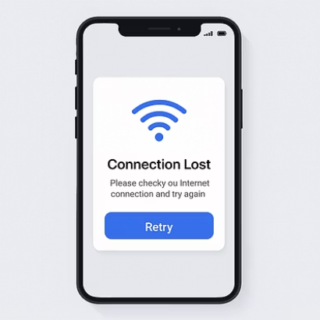
Best Practice: Test Connectivity Scenarios
Comprehensive connectivity testing ensures your app performs reliably across various network conditions. Test your application's behavior on Wi-Fi, mobile data (2G/3G/4G/5G), and in offline scenarios to identify and address potential issues.
Implement intelligent retry logic for failed requests, using exponential backoff to prevent overwhelming the server. Design your app with offline-first principles, allowing users to continue working without an internet connection and synchronizing data when connectivity is restored.

Slide 17
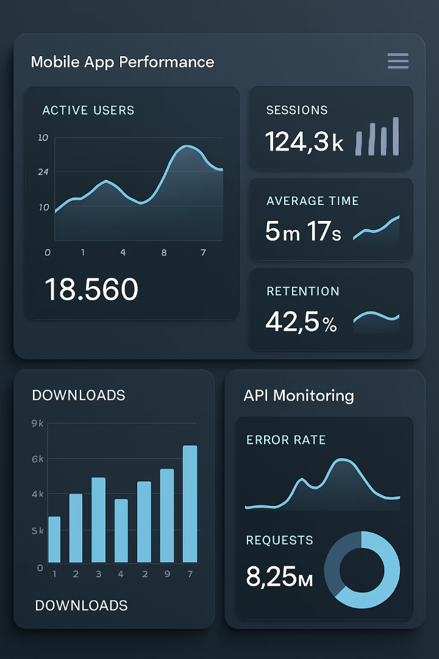
Best Practice: Monitor Performance
99.9%
<500ms
Uptime Target
Response Time
Aim for consistent availability of your API services
Optimal API response time for smooth user experience
<1%
Error Rate
Acceptable threshold for API request failures
Implement comprehensive monitoring and analytics to track API performance, response times, and error rates. Use tools like Firebase Performance Monitoring, New Relic, or custom analytics solutions to identify bottlenecks and optimize your app's performance.
Regularly review performance metrics to detect trends and address issues before they impact users. Monitor both client-side and server-side performance to get a complete picture of your application's behavior in real-world conditions.

Slide 18





Key Consideration: Security
SSL/TLS Encryption
Authentication Methods
Always use SSL/TLS to secure communication between your app and server, preventing data interception during transmission.
Implement strong authentication like OAuth 2.0 or JWT to ensure only authorized users can access your data.
Data Protection
Regular Security Audits
Apply encryption to sensitive data both in transit and at rest, and implement proper access controls at the database level.
Conduct periodic security reviews and penetration testing to identify and address vulnerabilities.

Slide 19




Key Consideration: Performance
Optimize Query Efficiency
Network Bandwidth
Design efficient database queries that minimize data transfer by requesting only necessary information. Consider pagination or cursor-based approaches for large datasets to reduce load times.
Implement data compression techniques to reduce payload size by up to 70%. Consider binary formats like Protocol Buffers for efficiency over JSON when transferring large amounts of data.
Battery Impact
Caching Strategy
Minimize constant polling by implementing batch operations and optimizing synchronization intervals. Balance real-time requirements with energy efficiency to preserve device battery life.
Implement a robust caching layer to reduce database calls and improve response times. Use a combination of memory, disk, and HTTP caching with appropriate invalidation policies.
Optimizing performance is essential for delivering a seamless user experience. Efficient API design significantly reduces response times and eliminates communication bottlenecks between your app and remote databases. Strategic local caching of frequently accessed data dramatically improves app responsiveness by minimizing unnecessary network requests.
Implement advanced techniques like request batching to consolidate multiple API calls into single transactions, data compression to minimize payload sizes, and comprehensive image optimization to accelerate loading in media-rich applications. When applied systematically, these performance strategies transform your mobile application into a responsive, efficient system that users will appreciate.

Slide 20


Key Consideration: Scalability
Infrastructure Scaling
Ability to handle growing user base
Database Architecture
2
Efficient data storage and retrieval
API Design
Optimized for high volume requests
Scalability ensures your app can handle growth without performance degradation. Choose a database architecture that can scale horizontally as your user base expands, allowing you to add more resources to meet increasing demand.
Design your APIs with scalability in mind, implementing pagination, rate limiting, and efficient query patterns. Consider using cloud-based solutions that offer automatic scaling capabilities, allowing your infrastructure to adapt dynamically to changing load conditions without manual intervention.

Slide 21





Key Consideration: Data Consistency
Local Data Storage
App maintains a local copy of relevant data for offline access and performance
Synchronization Logic
Algorithms determine how and when to reconcile local and remote data
Remote Database
Central repository maintains the authoritative version of all data
Conflict Resolution
Strategies for handling conflicting changes from multiple sources

Slide 22

Key Consideration: Network Reliability
Connection Lost
App detects network interruption and switches to offline mode
2
Local Operation
User continues working with locally cached data
Connection Restored
App detects network availability
Data Synchronization
Local changes are synced with remote database
Network reliability features ensure your app handles internet interruptions gracefully. Implement connection monitoring to detect when network status changes and respond appropriately. When connection is lost, enable offline mode and store user actions locally.
Develop intelligent retry logic with exponential backoff to resend failed requests without overwhelming the server or draining battery. Design synchronization mechanisms that can handle complex scenarios like conflicting changes or partial sync failures, maintaining data integrity throughout the process.

Slide 23
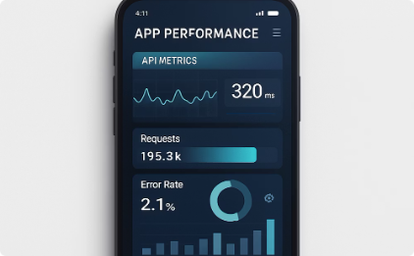


Key Consideration: Monitoring and Analytics
Performance Metrics
Track response times, error rates, and throughput to identify bottlenecks and optimize performance. Monitor both client-side and server-side metrics for a complete picture.
Error Tracking
Implement comprehensive error logging to capture details about crashes, API failures, and other issues. Group similar errors to prioritize fixes based on impact.
User Behavior
Analyze how users interact with your app, particularly around database operations, to identify opportunities for optimization and feature enhancement.

Slide 24








Key Consideration: Testing
Unit Testing
Integration Testing
Test individual components in isolation
Verify components work together correctly
Performance Testing
End-to-End Testing
Evaluate under various load conditions
Test complete user flows and scenarios
Comprehensive testing ensures reliable connectivity between your mobile app and remote databases. Unit tests verify that individual components handle database operations correctly, while integration tests confirm that these components work together as expected.
End-to-end testing validates complete user flows, including database interactions, across different network conditions. Performance testing under various loads helps identify bottlenecks and ensures your app remains responsive even during peak usage. Implement automated testing pipelines to catch issues early in the development process.

Slide 25

Key Takeaways
Connection Methodologies
RESTful APIs, GraphQL, and WebSockets each offer distinct advantages for different use cases. Choose the right approach based on your app's specific requirements for data access patterns and real-time needs.
Real-World Applications
User authentication, data synchronization, and dynamic content management demonstrate how remote database connectivity enhances app functionality and user experience across various domains.
Best Practices
Optimize network usage, handle errors gracefully, secure data transmission, test connectivity scenarios, and monitor performance to create reliable and efficient mobile applications.
Key Considerations
Security, performance, scalability, data consistency, network reliability, monitoring, and testing are critical factors that ensure your mobile app remains secure, responsive, and reliable when interacting with remote databases.

